Slide 1

TATA-IQ Data Visualization: Empowering Business with Effective Insights

Slide 2
Forage Virtual Internship Program with TATA Insights & Quants
This project was a prerequisite for the completion of the virtual experience program with Tata Insights and Quants or Tata iQ, made possible by Forage.

Slide 3
INTRODUCTION
In today's presentation, we'll explore the exciting world of data visualization and how it plays a vital role in the Forage Tata Virtual Internship program.
Data visualization is more than just creating pretty charts; it's about transforming complex data into meaningful insights that drive decision-making and innovation.

Slide 4
SCENARIO
I have been hired by an online retail store as a consultant to review their data and provide insights that would be valuable to the CEO and CMO of the business.
The business has been performing well and the management wants to analyze what the major contributing factors are to the revenue so they can strategically plan for next year.
The leadership is interested in viewing the metrics from both an operations and marketing perspective.
Management also intends to expand the business and is interested in seeking guidance into areas that are performing well so they can keep a clear focus on what’s working.
They would also like to view different metrics based on the demographic information that is available in the data.

Slide 5


Process
1
Data Understanding
2
Data Cleaning
PROCESS
3
Modeling
4
Data Analysis
5
Uncover Insights
Notes:
So, how did we tackle this problem?
Well, we approached it in 5 steps:
1. Data understanding - the key to success on any data project is to understand the data in detail. So we took the time to understand the data model and domain of your business.
2. Data extraction - after understanding your business, we then architected what an ideal dataset should look like for this problem and extracted it from the relevant data sources.
3. After extracting the raw data, we needed to process and model this data into a dataset that can precisely answer the business questions and produce analytics.
4. With our new dataset, we used our analytical expertise to uncover insights from this dataset and to produce visualizations to describe the insights.
5. And finally we used these insights to unlock business decisions and to make recommendations on next steps.

Slide 6
DATA CLEANUP
Before you can begin the analysis, make sure that the data is cleaned properly.
You have noticed that the data contains some returns to the store which are provided in negative quantities and there are unit prices that were input in error.
You will need to perform the following steps to clean this data:
Create a check that the quantity should not be below 1 unit
Create a check that the unit price is not below 0
.

Slide 7
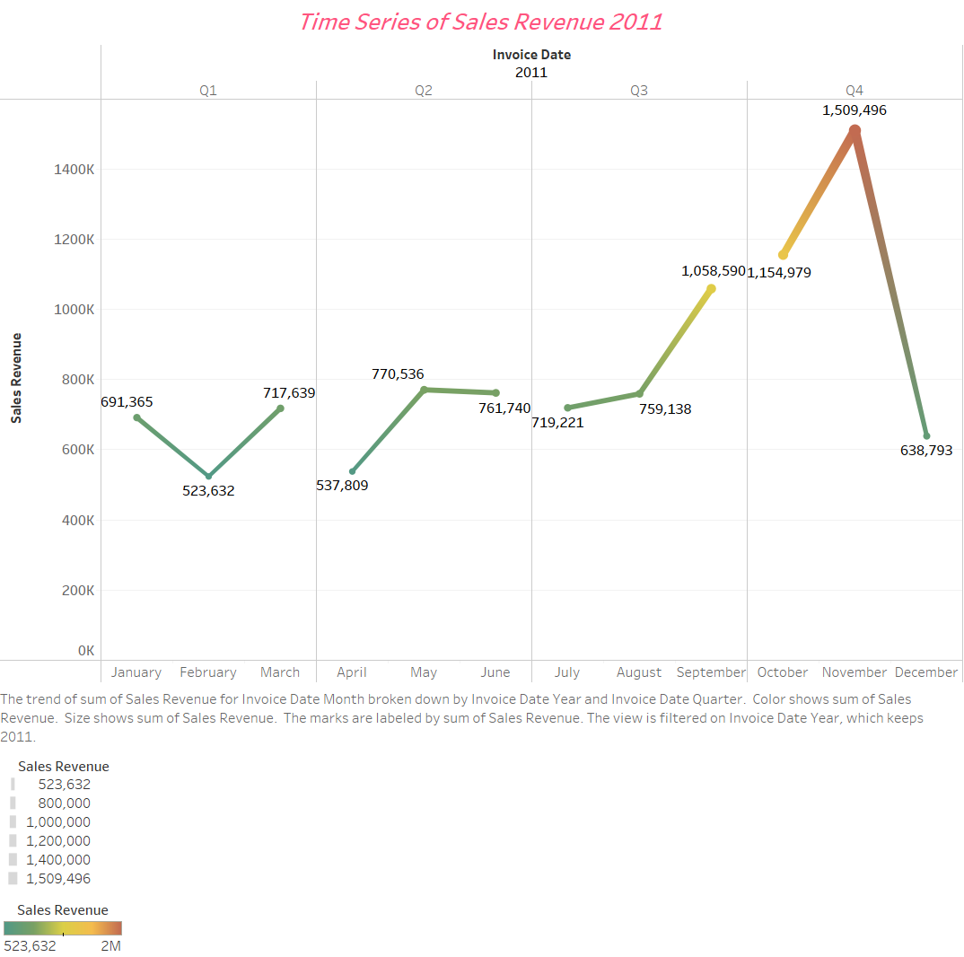
ANALYSIS
Revenue Trend
Notes:
According to the CEO's request, my examination of the revenue pattern reveals that there are select months of the year that have remarkable growth. According to the data, the first eight months' sales were very stable, with an average of $685k in revenue each month. The revenue rises by 40% over the prior month in September, marking the beginning of the revenue boom. This pattern persisted up until November, when it rose to 1.5 million USD, the greatest amount of the entire year. Unfortunately, since the data for December is lacking, no inferences can be made from it. This analysis demonstrates how seasonality, which typically occurs in the last four months of the year, affects retail store sales.

Slide 8
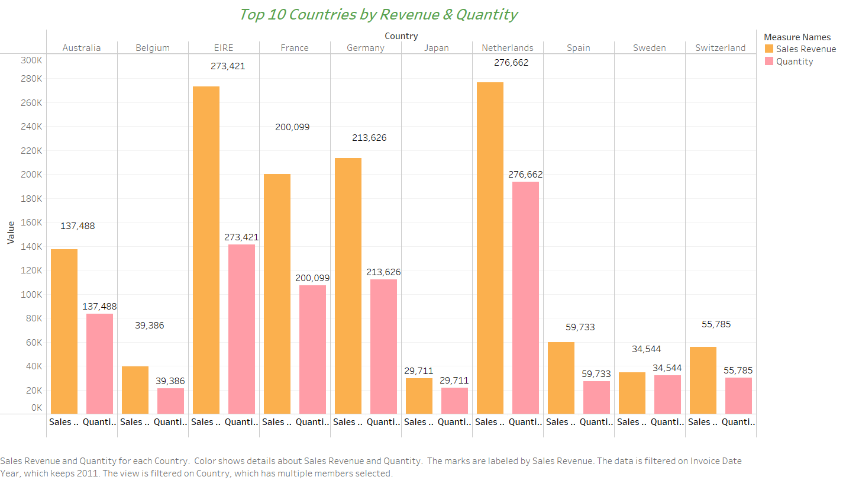
Countries by Revenue and Quantity
Notes:
The second visual shows how the top 10 countries which have opportunities for growth are performing. This data is focused on the countries where demand can be increased as per the CMO's request, hence the UK has been excluded since it already has high demand. My analysis shows that the Netherlands, Éire, Germany, France and Australia are the countries with high volumes of units bought and revenue generated. I advise that an expansion strategy should be initiated to target these regions and generate more business growth.

Slide 9
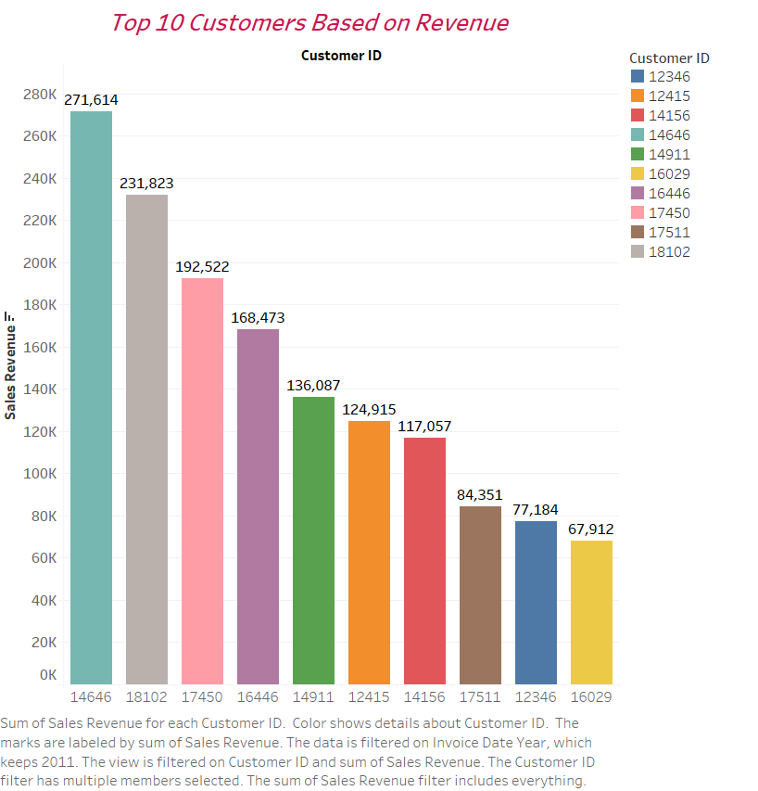
Understanding Customers' Purchasing Power
Notes:
The top 10 consumers who have made the most purchases from the store were the subject of this investigation. According to the data, there aren't many differences between the top 10 customers' purchases. The fact that the highest revenue-producing customer only spent 17% more than the second-highest demonstrates that the company does not rely solely on a small number of consumers to generate income. This demonstrates that the company is in a strong position and that the customer's power of negotiation is low. If the reverse was the case, then the company would need to diversify it's customer base in other to gain upper hand in customers negotiation power.

Slide 10
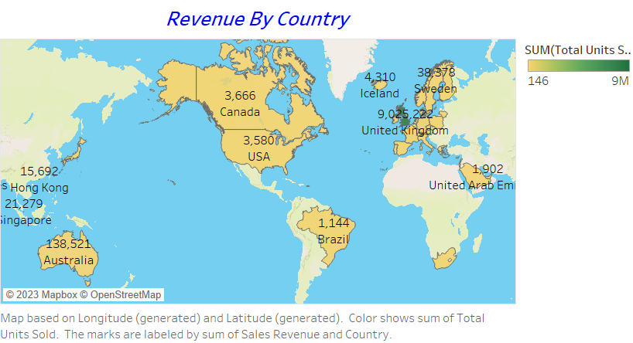
Product Demand Across Regions
Notes:
This map chart contrasts the regions that have and have not produced the highest revenue to illustrate which regions have. Apart from the UK, it is clear that nations like the Netherlands, Éire, Germany, France, and Australia generate significant revenue, and the business should make additional investments there to boost product demand. The map also reveals that the majority of sales occur only in the European zone, with only a small number in the American region. Asia, Africa, and Russia have no market demands for the products, hence there is a large market opportunity in these places, which will increase earnings and profitability.

Slide 11
CONCLUSION
The analysis is expected to provide a reasonable amount of insights/guidance to the management in their quest for business expansion, but any more analysis needed, or suggestions would be highly appreciated.

Slide 12
THANK YOU

